Slide 1
Business Process Management and Supply Chain Management using Microsoft Dynamics Customer Relationship Management (CRM)
Dr. Huei Lee, Eastern Michigan University, Huei.Lee@emich.edu
Dr. Kuo Lane Chen, University of Southern Mississippi

Slide 2
The Outline for the Course
Lecture (15 – 20 minutes)
  Introduction to supply chain management (SCM) & business process management (BPM)
  Major CRM systems
  Why do we choose Microsoft Dynamics CRM in SCM and BPM courses?
  Important features of Microsoft Dynamics CRM
  An example: sales management processes using Microsoft Dynamics CRM
  The Dashboard in Microsoft Dynamics CRM
  Security and auditing features of Microsoft Dynamics CRM
  Social CRM and mobile devices

Slide 3
The Outline for the Course (Continue)
Step-by-step Handouts Exercises (40 minutes)
  How to access Microsoft Dynamics CRM systems and create your own account (5-10 minutes)
  Basic features in Microsoft Dynamics CRM Online and sales process management (15 minutes)
  Security and auditing control in Microsoft Dynamics CRM (10 minutes)
Post Assignment & Assessment (3 minutes)
Questions (2 minutes)

Slide 4
I. Lecture (15-20 minutes)
Dr. K Chen & H. Lee

Slide 5
Introduction
The Role of Supply Chain Management in the US and Global Economics
The Importance of Information Technology and Supply Chain Management
Business Process Management and Supply Chain Management

Slide 6
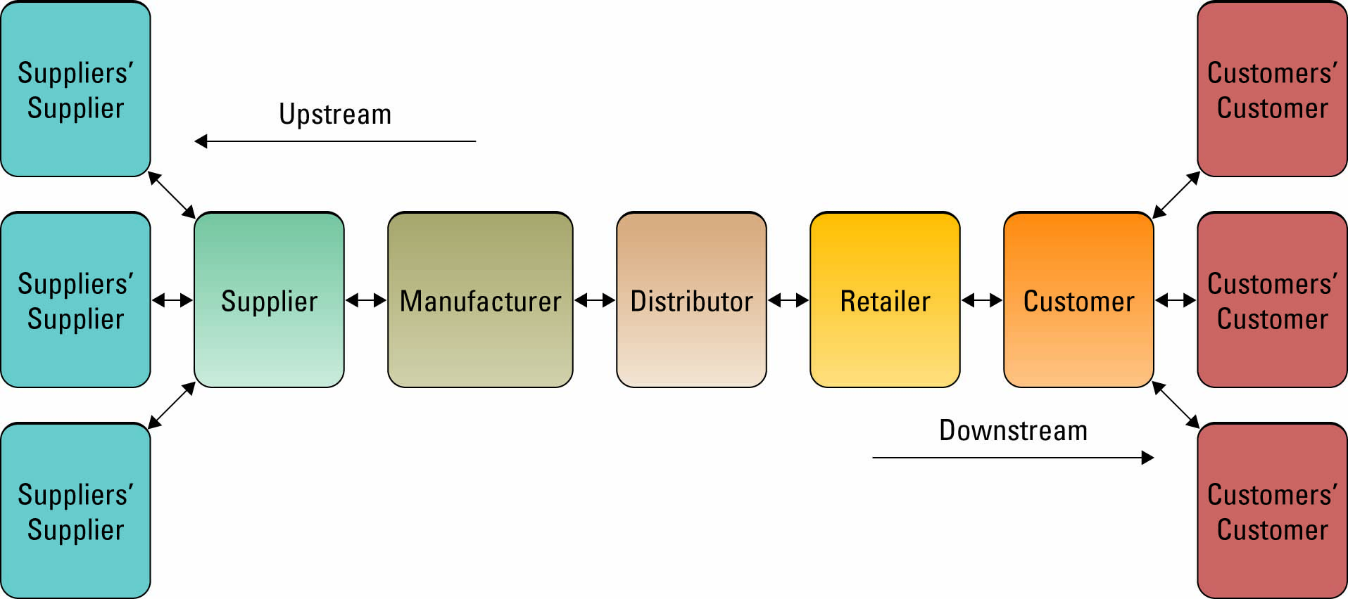
Business Process Management & Supply Chain Management
Supply Chain Management
ERP (enterprise resource planning software)
CRM
SRM
Database/
Data warehouses
BI
* Source: Baltzan & Phillips 2009

Slide 7
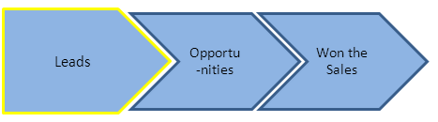
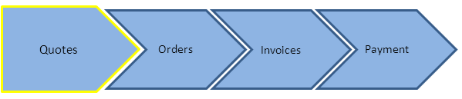
CRM uses the principles of Business Process Management (BPM)
Sales Process Management

Slide 8
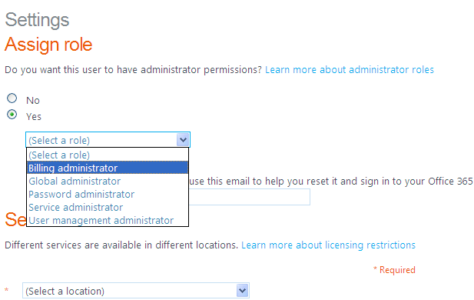
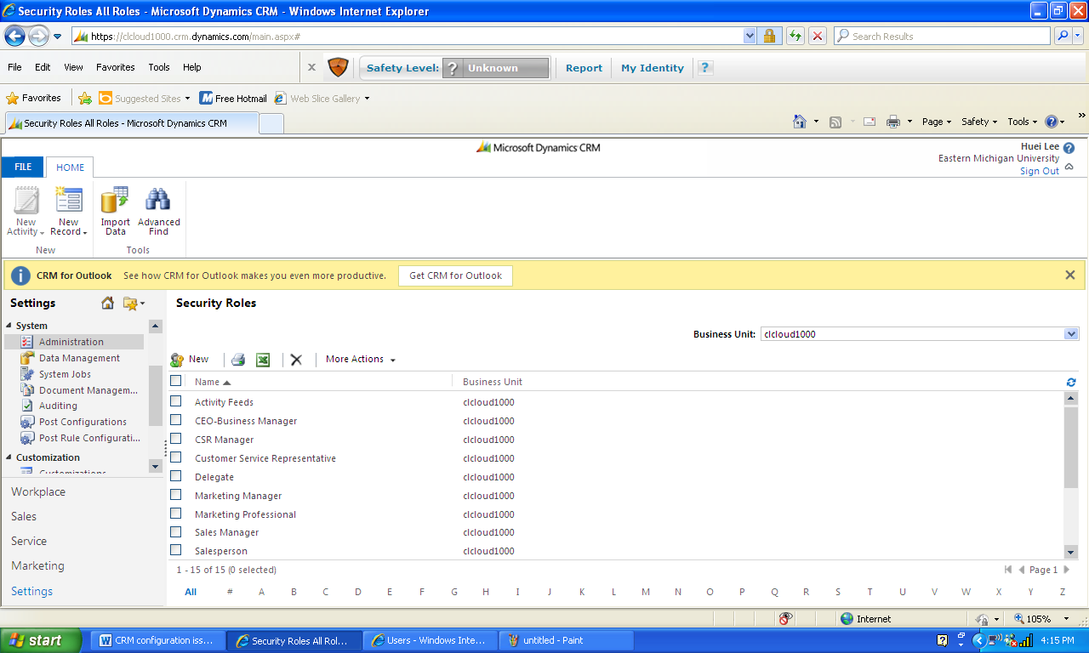
Microsoft Dynamics CRM - Security and Auditing Features
Assigned to different roles

Slide 9
Customer Relationship Management (CRM) Systems
Customer relationship management (CRM) systems, sometimes called e-CRM systems, use technology to help an e-business manage its customer base
CRM allows an e-business to match customer needs with product plans and offerings, remind customers of service requirements, and determine what products a customer has purchased

Slide 10
CRM and Marketing Management
Marketing resource and marketing management
  Manage and optimize the use of marketing resources including budgets, people, time, and assets.
  Align all activities and resources around strategic marketing goals.
  Gain visibility and control into your marketing processes.
  Accurately manage the marketing budgets and costs.
  Increase brand awareness with proper usage and consistency across enterprise and third-party agencies.
  Facilitate collaboration among team members and coordinate marketing activities across the enterprise.

Slide 11
Major CRM Systems
SAP CRM
Oracle Siebel CRM
Salesforce.com
Microsoft Dynamics CRM

Slide 12
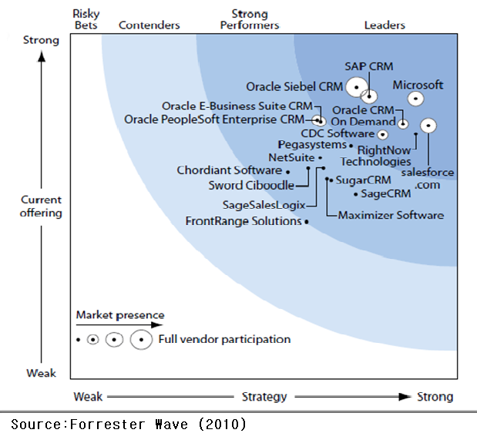
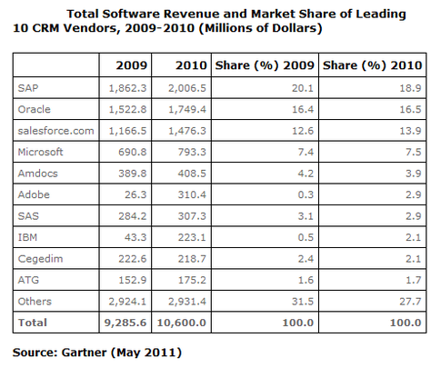
Major CRM Systems
SAP CRM
Oracle Siebel
Salesforce.com
Microsoft Dynamics CRM

Slide 13
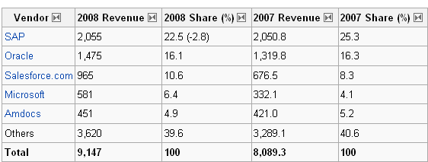
Market Share of CRM Systems (2007-2008)

Slide 14
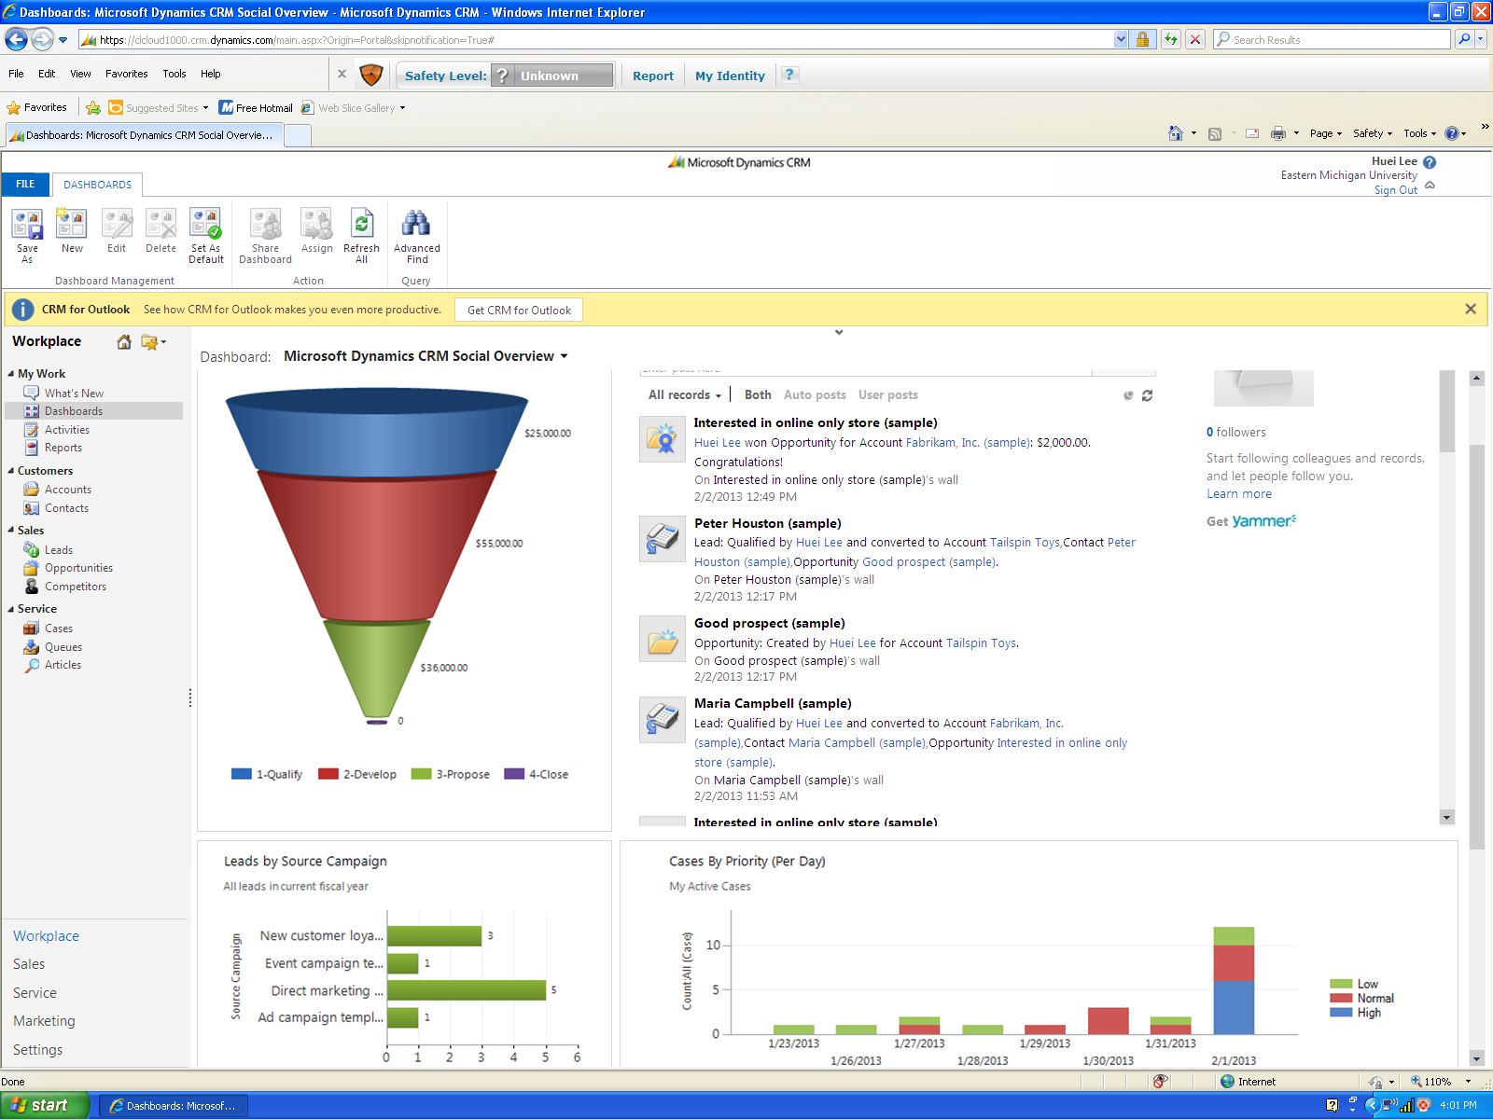
Microsoft Dynamics CRM

Slide 15
Why We Choose Microsoft Dynamics CRM?
It's priced at least 30 percent less than equivalent offerings from Salesforce (and comparisons offered in the article make it clear that Salesforce charges a premium over not just Dynamics but other alternatives such as Oracle Siebel CRM OnDemand and Sugar CRM Professional On-Demand).
Customers will welcome a legitimate alternative to Salesforce.
Dynamics integrates with all of the usual Microsoft suspects, including Office, Office 365, Content Management Server, Mobile and MapPoint.
Microsoft is working on a process-oriented, end-to-end CRM approach involving Sharepoint Server, BizTalk, Exchange and other Microsoft technologies that will emphasize not only internal collaboration but collaboration with customers.

Slide 16
How to access Microsoft Dynamics CRM?
Three different ways to access MS Dynamics CRM:
  A) Create your own server (For example, my server is
    http://99.140.126.13
  B) 30 days free trial for MS Dynamics CRM:
http://crm.dynamics.com
  C) Request accounts from Microsoft Dynamics Academic Alliance.
You have to use the Internet Explorer to access the CRM.
Dynamics CRM can work with Microsoft Office 365, which has secure & anywhere access to email and calendars, Office Web Apps, instant messaging, conferencing, and file sharing.

Slide 17
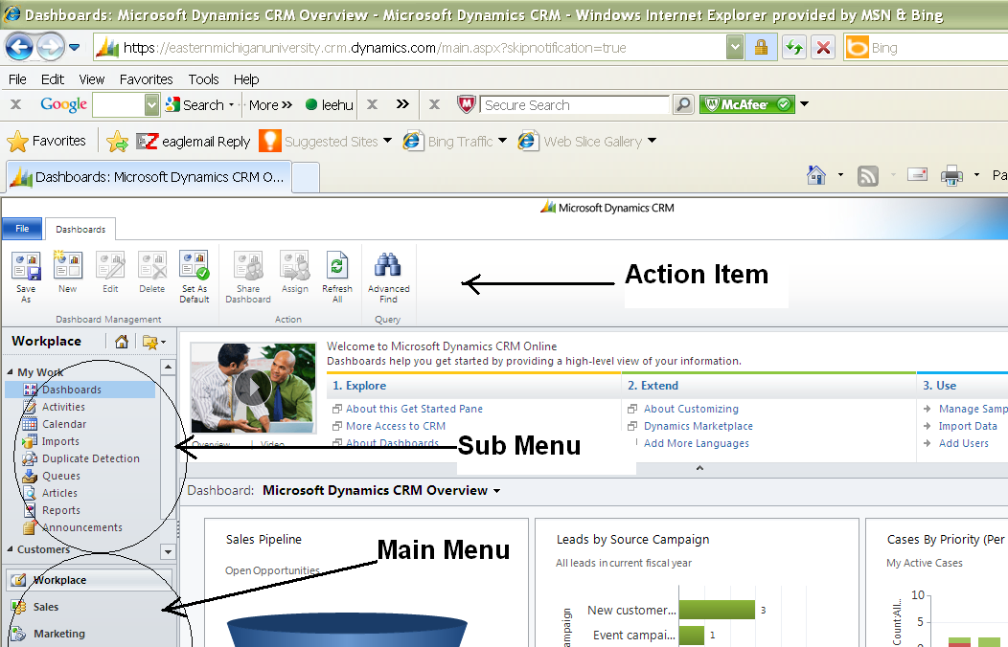
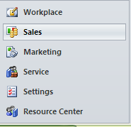
Main Menu for Dynamics CRM
Main menu

Slide 18
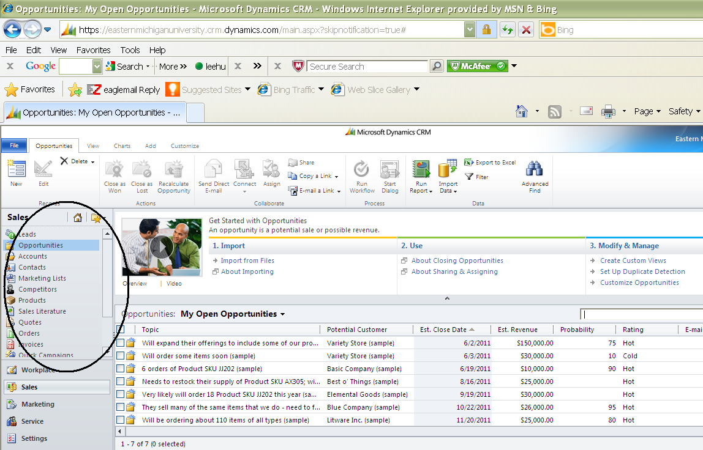
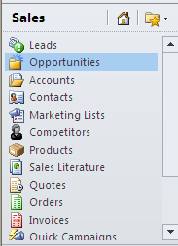
Submenu under a main menu
Opportunities submenu under Sales
Sales

Slide 19
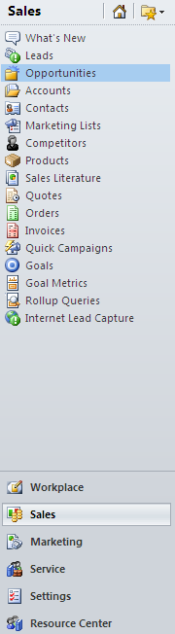
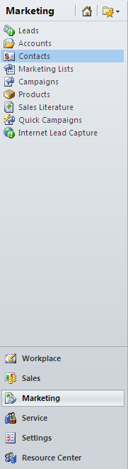
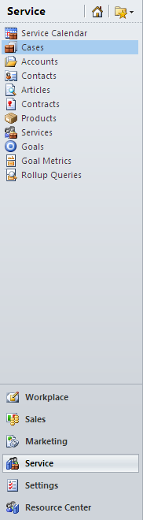

Menu for Microsoft Dynamics CRM

Slide 20
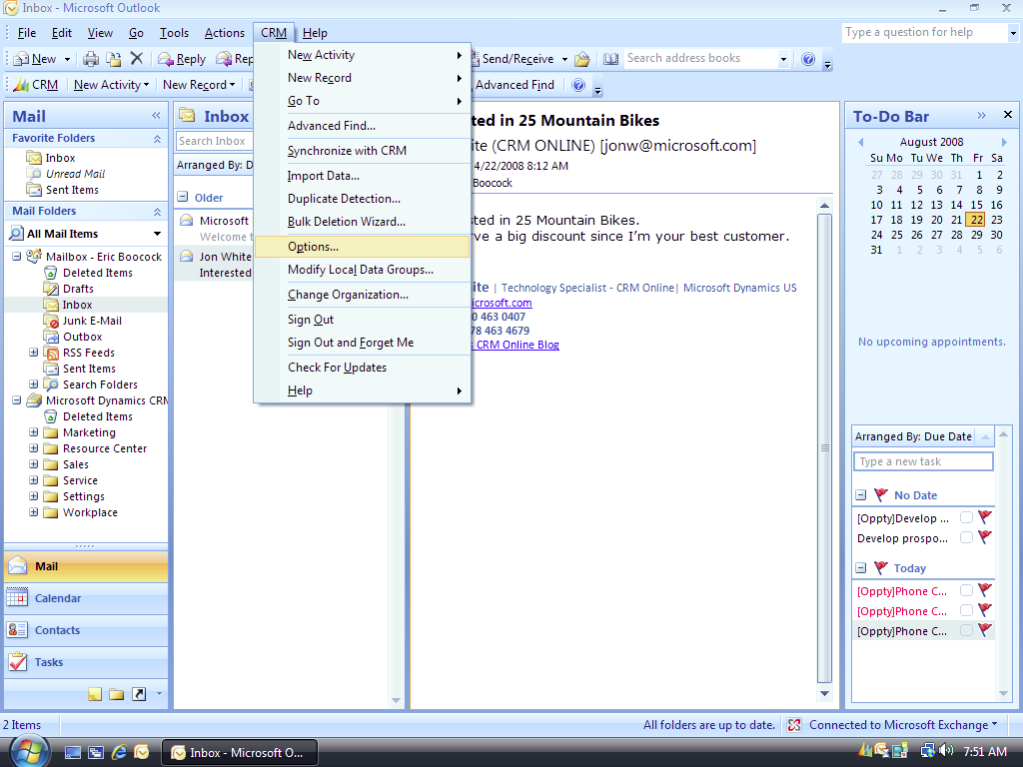
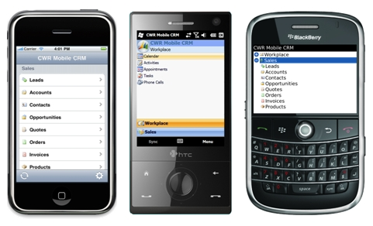
Microsoft Dynamics CRM on Mobile Devices

Slide 21
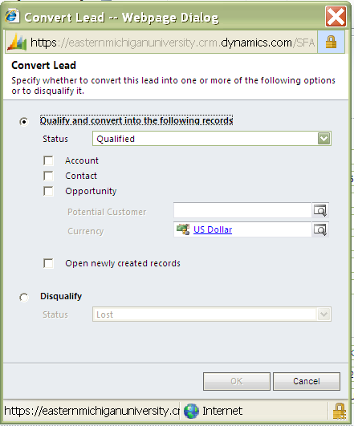
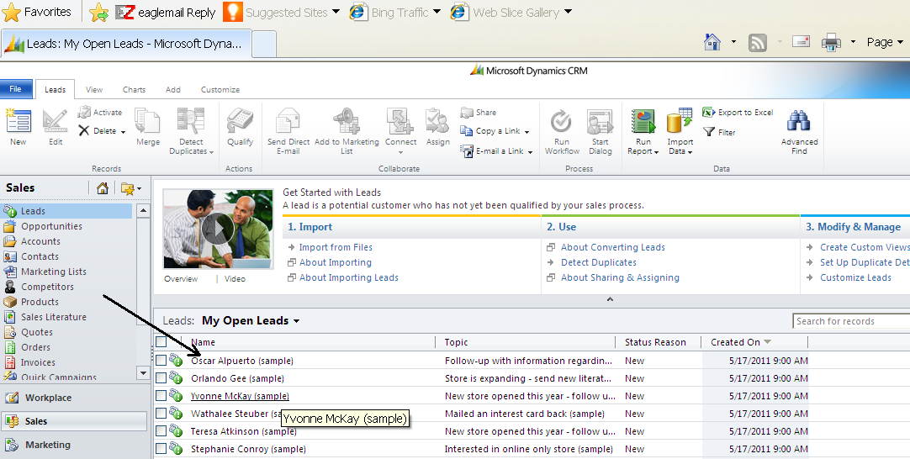
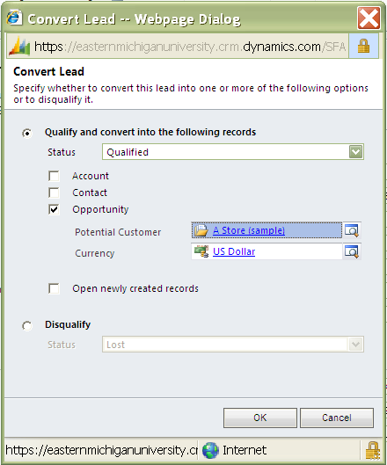
Leads and Opportunity

Slide 22
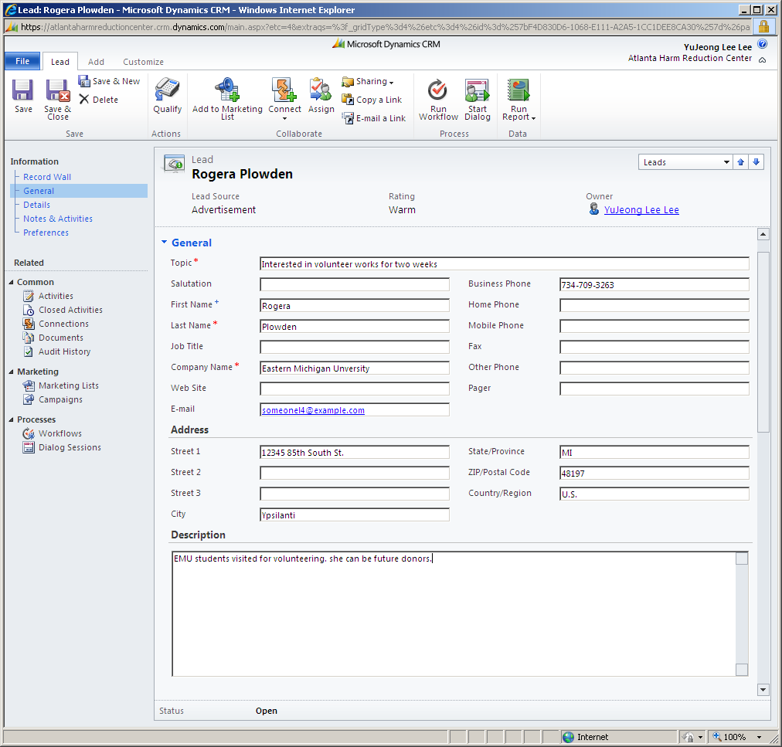
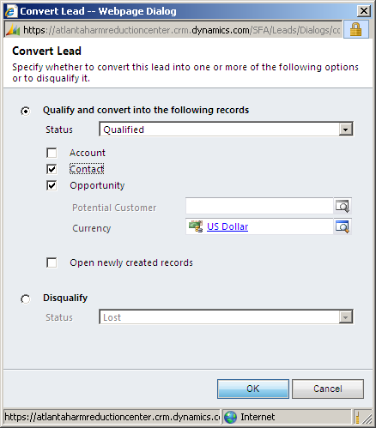

Slide 23
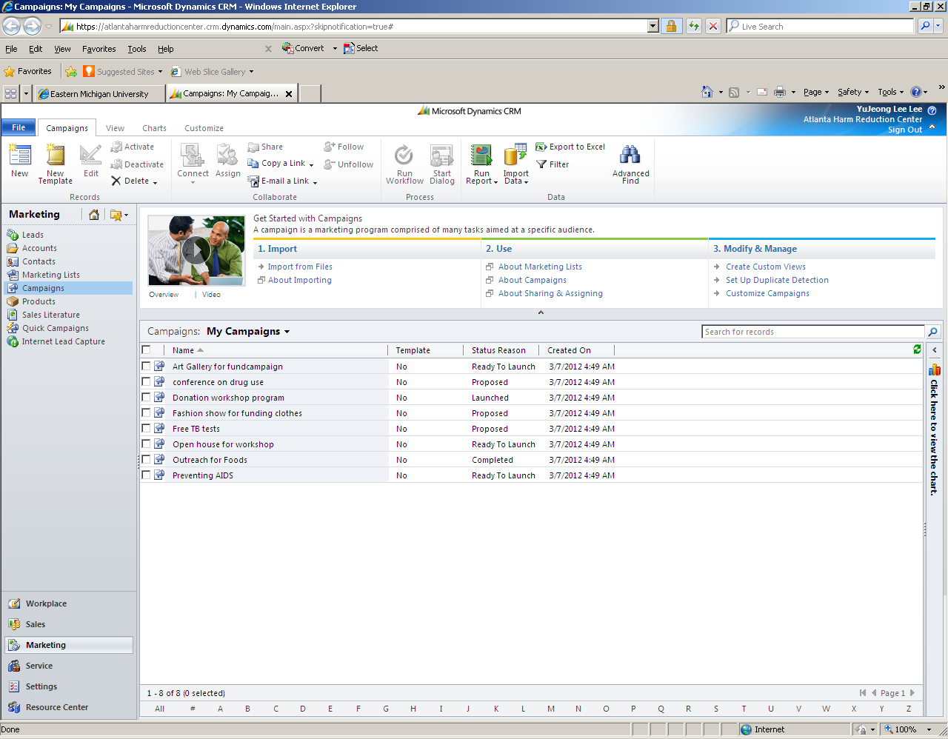
Campaigns

Slide 24
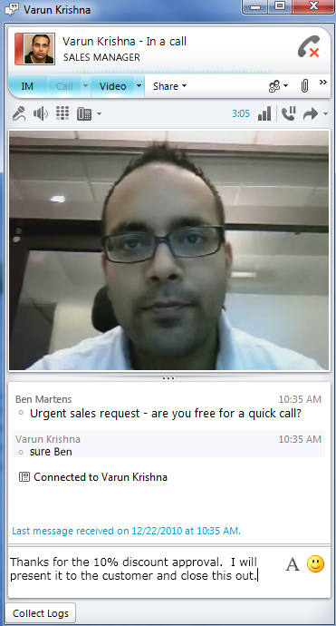
Immediately Handling for Reaching Sales

Slide 25
Dashboards
“Dashboards let you bring important data from different areas of your business into a single screen.”*
“Use dashboards to get a quick insight into important aspects of your business, such as day-to-day activities of team members, team goals, and sales performance, from one place instead of going to different areas of Microsoft Dynamics CRM to find the details”*

Slide 26
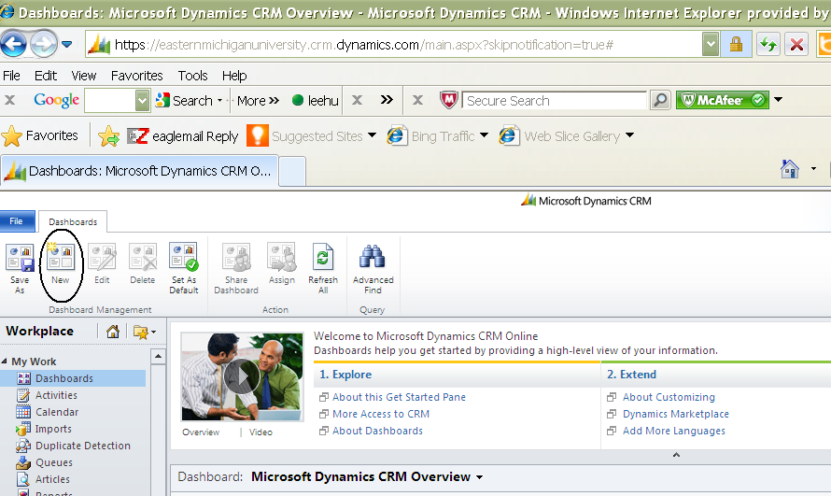
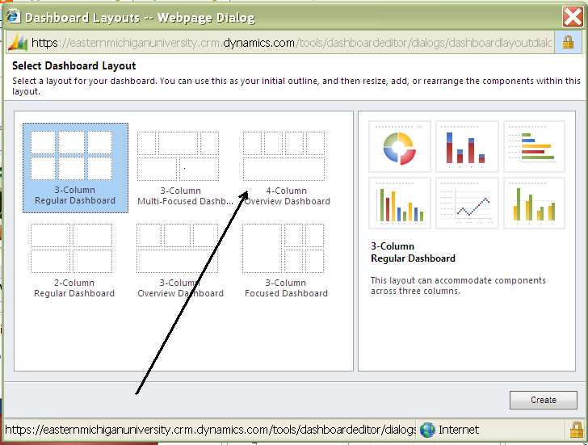
Dashboards

Slide 27
Components of Dashboard
You can add different components that you want to be displayed on your dashboard: 1) Chart 2) List, 3) IFrame, and 4) Web Resource

Slide 28
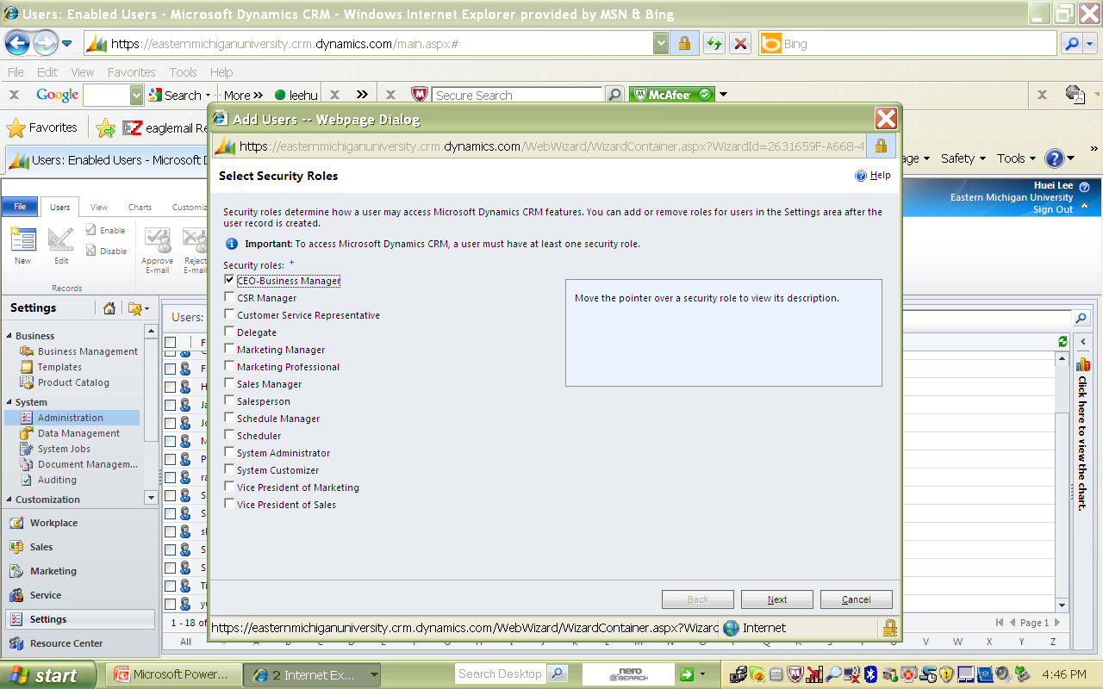
Security Role

Slide 29
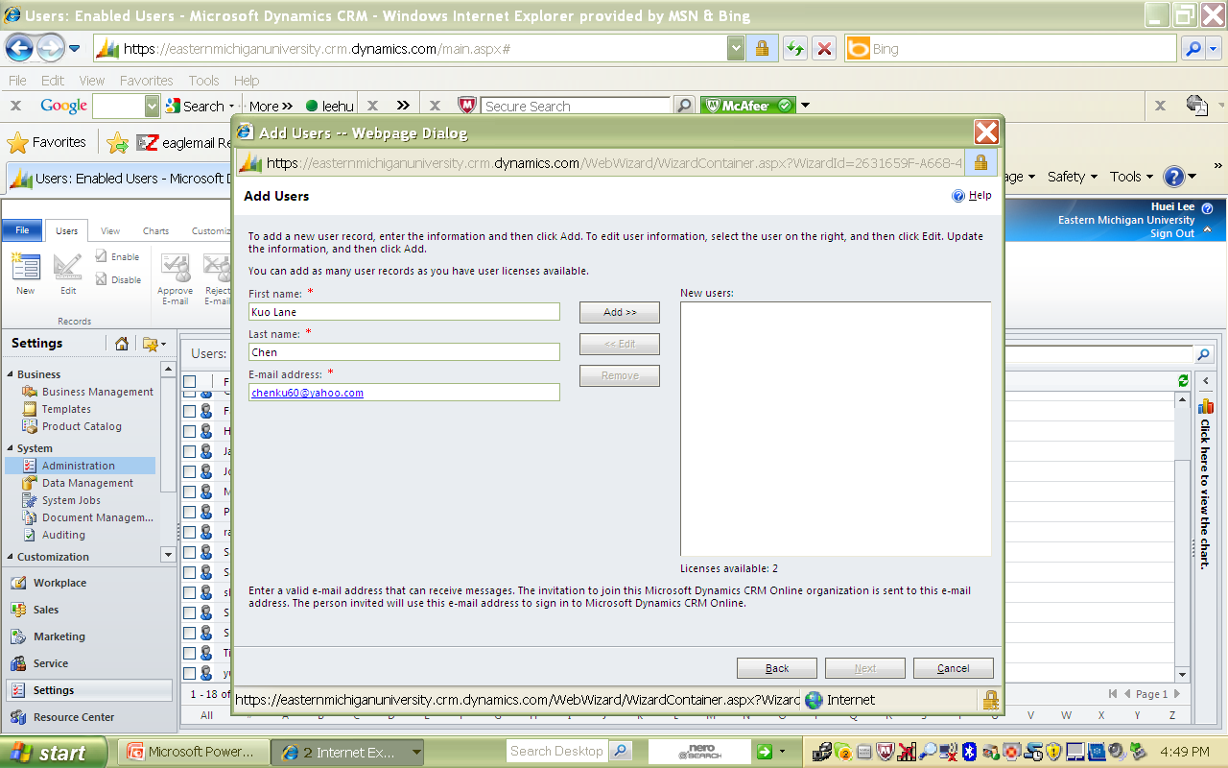
Add a user

Slide 30
Role and Task Assignment in a Business Process
 | Task 1 | Task 2 | Task 3 | Task 4 | Task 5
Role 1 | x | x | x
Role 2 |  |  |  | x | X
Role 3
Role 4 |  |  | x | X
Role 5 |  |  |  |  | X
Business Process

Slide 31
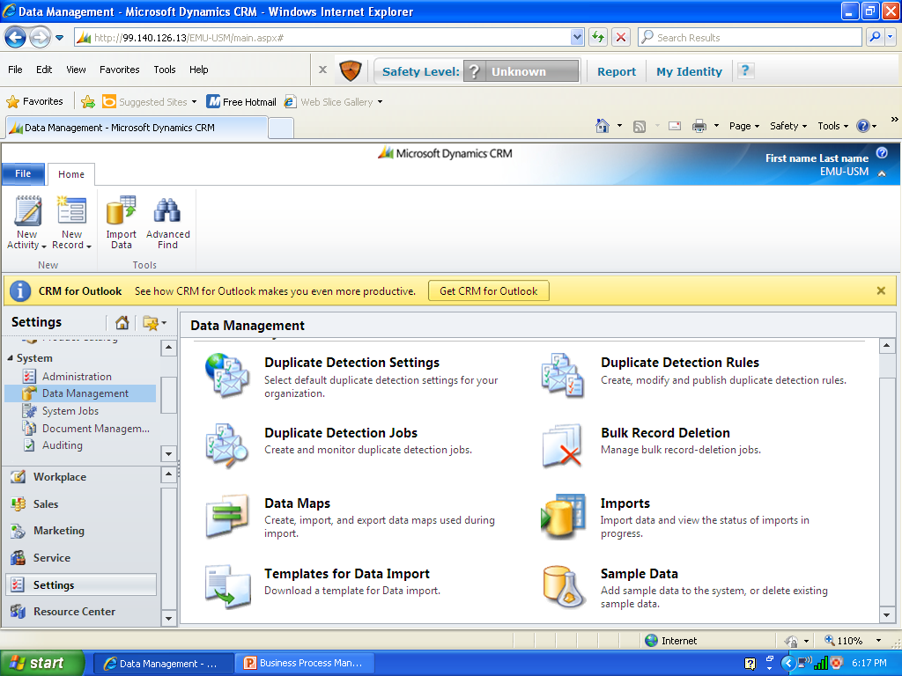
Install Sample Data
Setting -> Data Management -> Sample Data

Slide 32
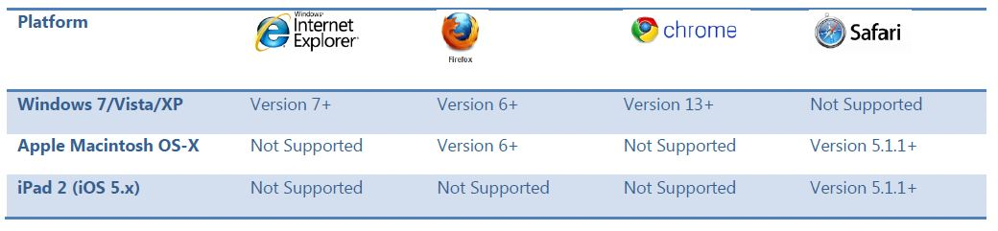
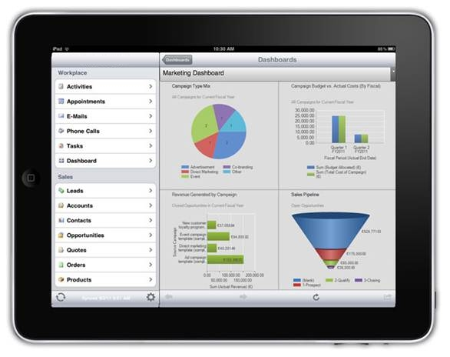
Browsers Compatibility of Microsoft Dynamics CRM software
Can use Microsoft dynamics CRM 2011 at the Internet Explorer only, cannot use it at other browsers

Slide 33
II. Step-by-step Hands-on Exercises
A1. How to access Microsoft Dynamics CRM systems and create your own account
(5-10 minutes)

Slide 34
II. Step-by-step Hands-on Exercises (continue)
A2. Basic features in Microsoft Dynamics CRM Online and sales process management (15 minutes)

Slide 35
II. Step-by-step Hands-on Exercises (continue)
A3. Security and auditing control in Microsoft Dynamics CRM
(15 minutes)

Slide 36
Follow-up Assignments & Assessment

Slide 37
Question?

Slide 38
Thank you!
Dr. Huei Lee, Eastern Michigan University, Huei.Lee@emich.edu
Dr. Kuo Lane Chen, University of Southern Mississippi

